Slide 1







Slide 2
Strategic Website Design for Business Growth
MD MEHEDI HASAN POLASH (22-46566-1)
TRIDIB SARKAR
(22-46444-1)
MD RABIUL ISLAM ASIF
(22-48011-2)
AFSAR MAHBUB KHAN
(22-49366-3)
MD SAIDUL ISLAM
(22-49719-3)

Slide 3
LIST OF CONTENTS
INTRODUCTION
METHODOLOGY
RESULTS
DISCUSSION
CONCLUSION

Slide 4

INTRODUCTION
Purpose: To address common website design challenges and demonstrate how effective design fosters business growth.
Significance: Showcases the impact of user-friendly interfaces, mobile responsiveness, SEO, and modern tools on customer engagement & success

Slide 5

Methods:
Google Forms survey (20 questions) conducted from January 1–7, 2025, focusing on user preferences, design, and SEO.
Contributors:
30 participants, including business owners, developers, and frequent website users, selected for their insights into effective website strategies.
Solution:
Strategic website design with user-friendly interfaces, responsive layouts, SEO, e-commerce functionality, and analytics tools to enhance growth.

Slide 6
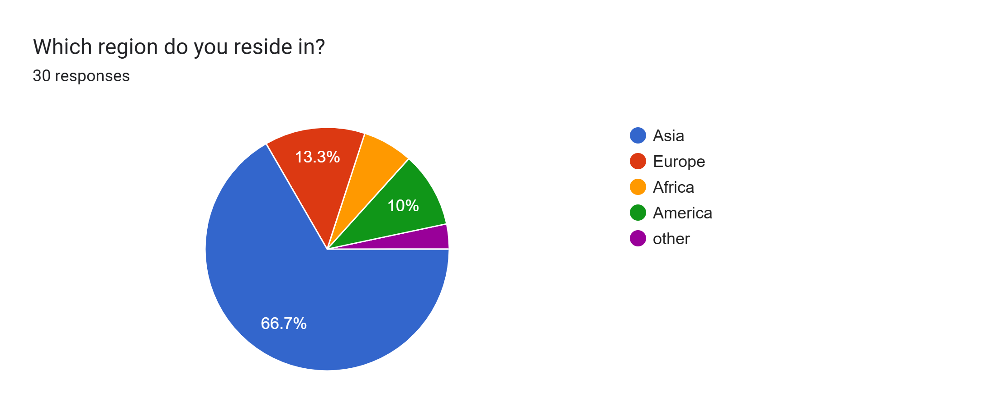
RESULTS
Participants from different parts of the world.

Slide 7
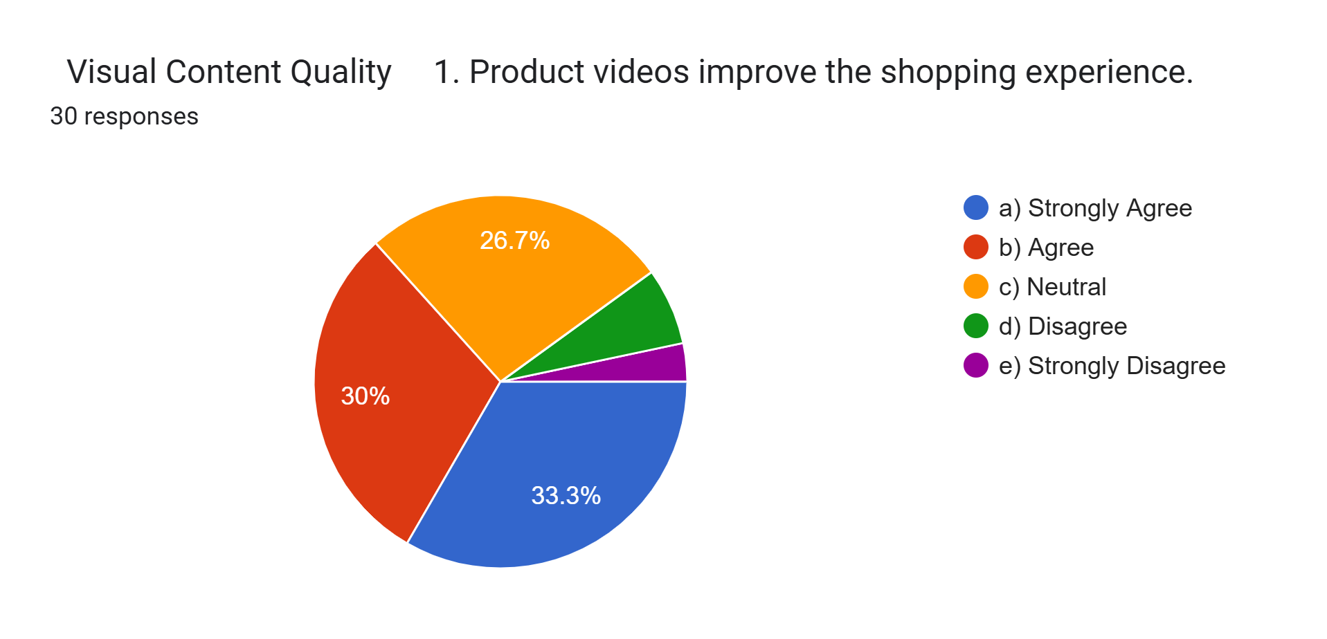
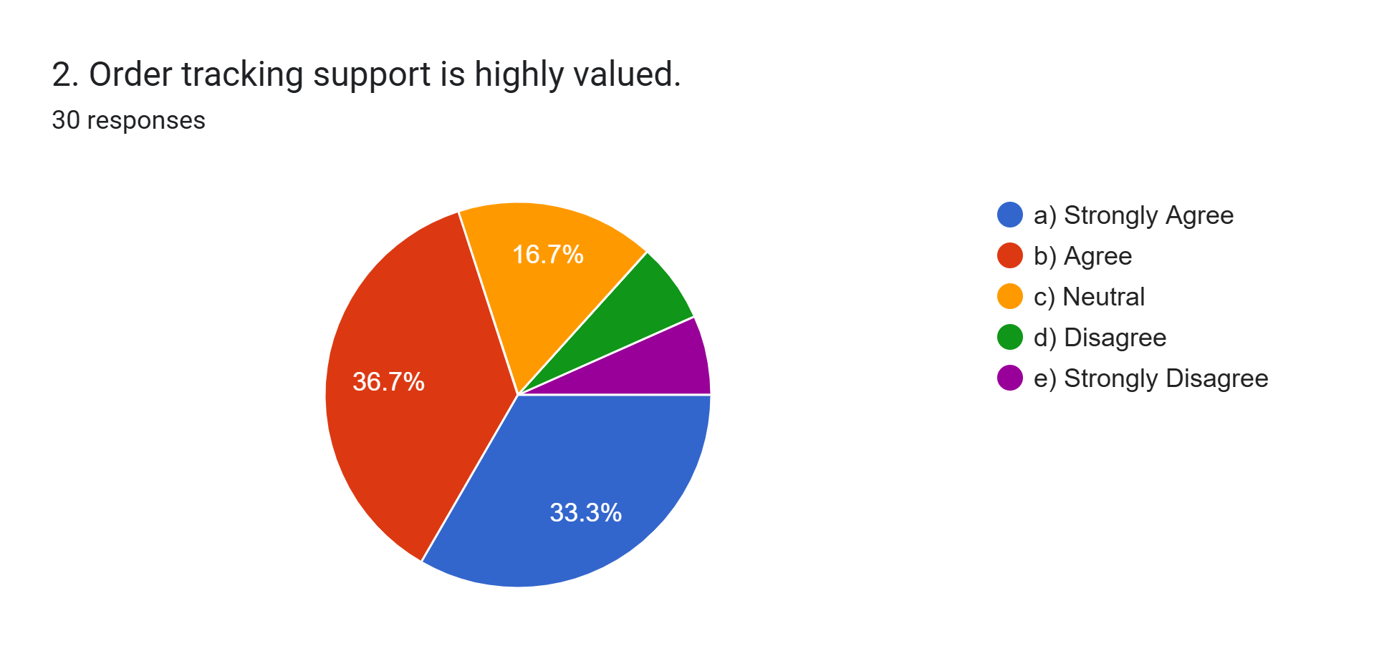
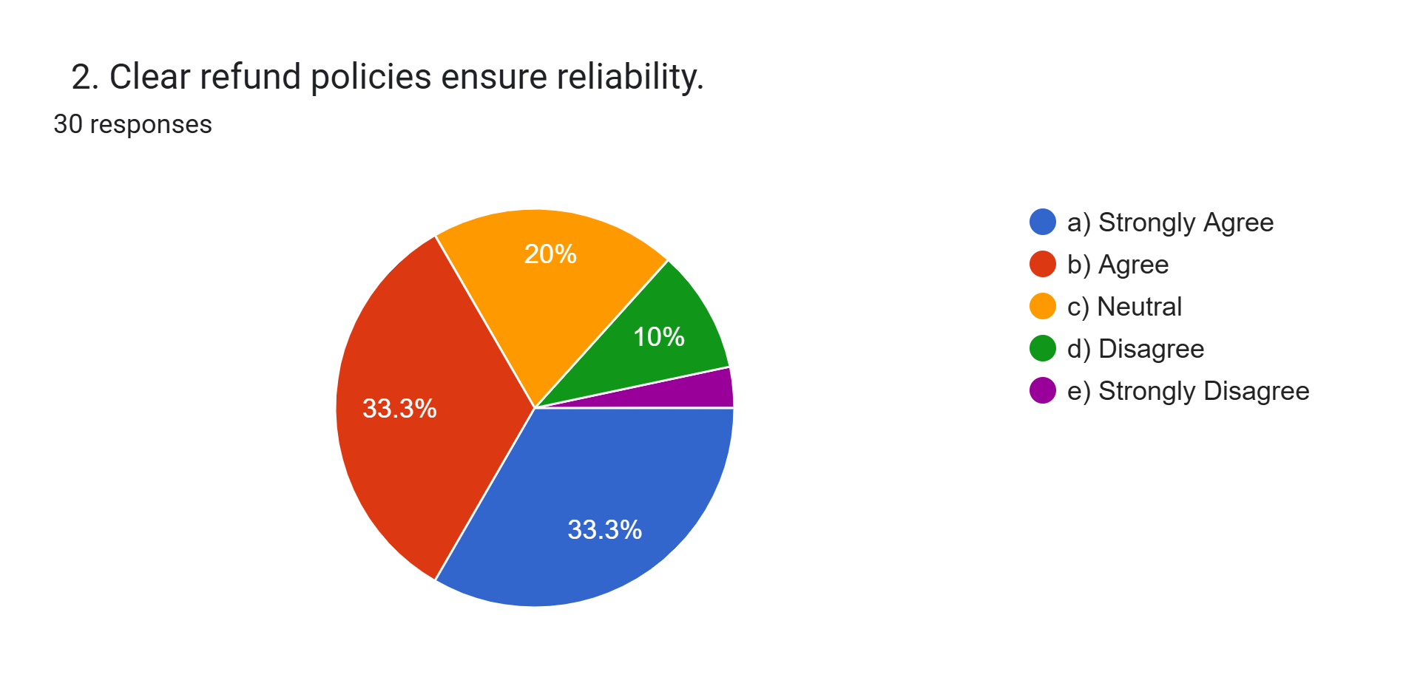
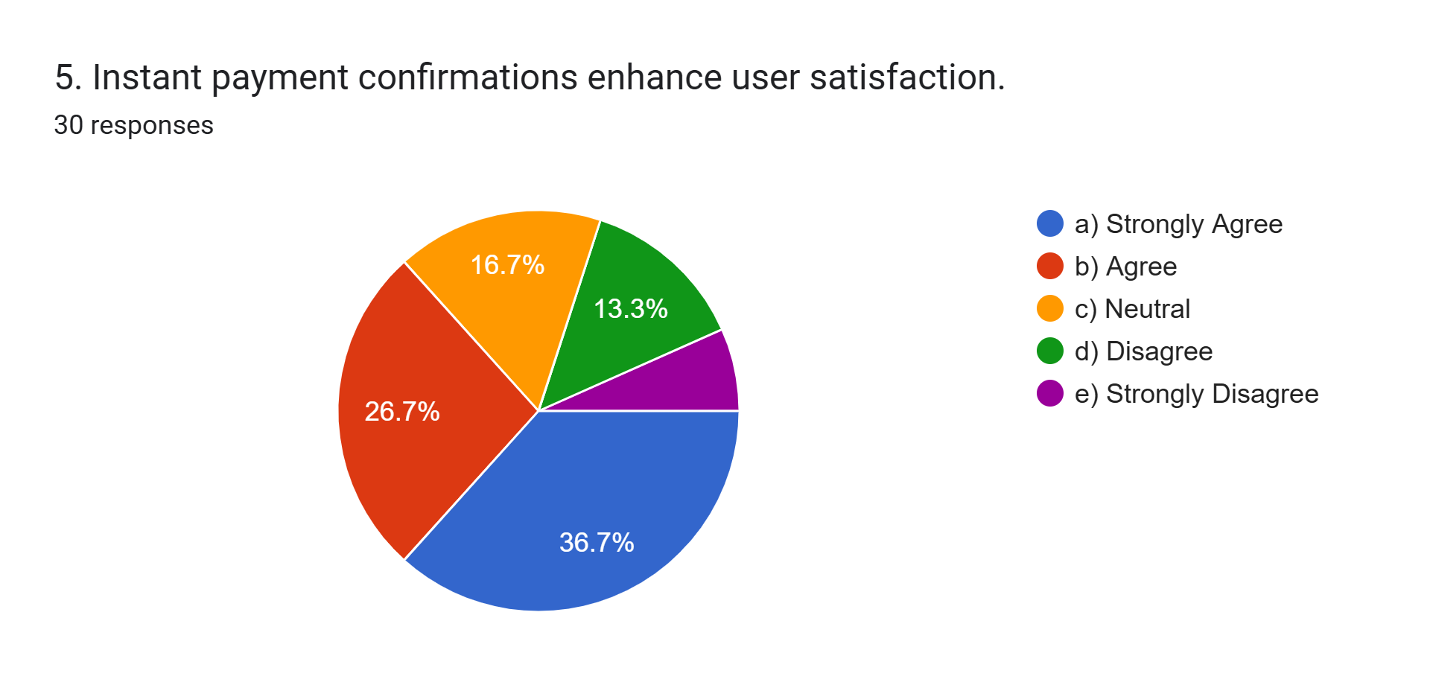

Slide 8
Table for customer support features
Question Number | Strongly Agree (5) | Agree (4) | Neutral (3) | Disagree (2) | Strongly Disagree (1) | Mean
1. | 10*5 = 50 | 11*4 = 44 | 5*3 = 15 | 3*2 = 6 | 1*1 = 1 | 116/30 = 3.86
2. | 10*5 = 50 | 11*4 = 44 | 5*3 = 15 | 2*2 = 4 | 2*1 = 2 | 115/30 = 3.83
3. | 12*5 = 60 | 8*4 = 32 | 7*3 = 21 | 3*2 = 6 | 0*1 =0 | 119/30 = 3.96
4. | 12*5 = 60 | 7*4 = 28 | 5*3 = 15 | 6*2 = 12 | 0*1 = 0 | 115/30 = 3.83
5. | 10*5 = 50 | 5*4 = 20 | 11*3 = 33 | 2*2 = 4 | 2*1 = 2 | 109/30 = 3.63
 |  |  |  |  |  | 19.11/5 = 3.82

Slide 9
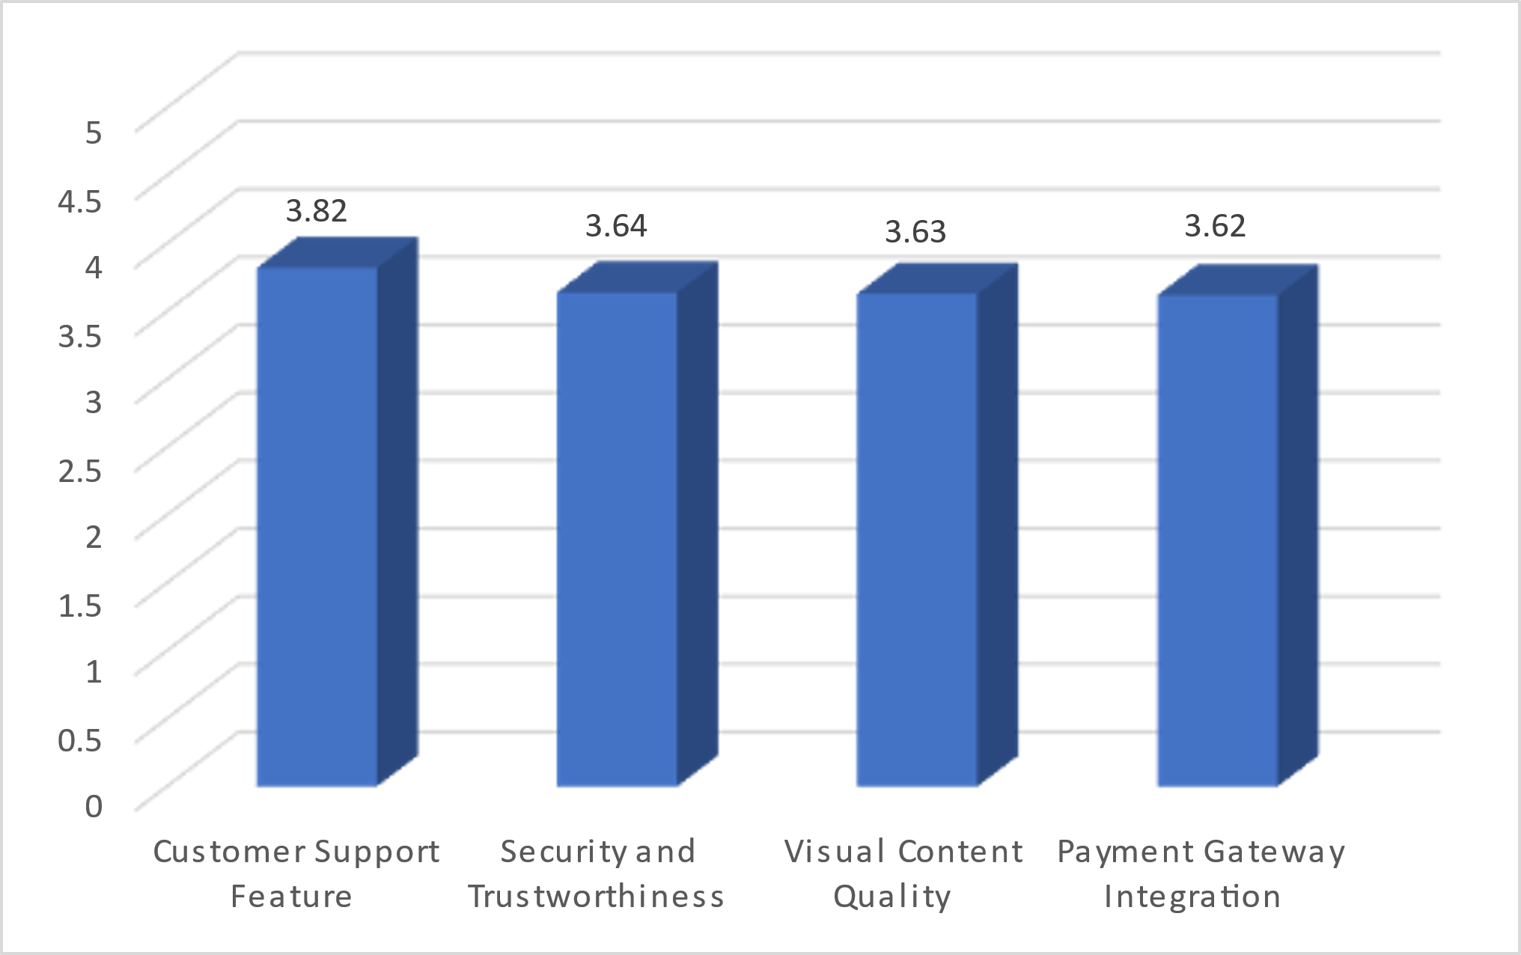
BAR GRAPH

Slide 10
DISCUSSION
Strategic Importance:
Website design significantly impacts business growth by enhancing user satisfaction, trust, and engagement.
Positive Features Identified:
Strong customer support.
High-quality visual content.
Secure payment gateway integration.
Improvement Areas:
Enhance website security.
Improve content alignment with user expectations.

Slide 11
conclusion
Key Features
Customer support
security
visual content
payment gateways
Role of Website Design
Boosts user satisfaction, trust, and engagement.
Business Impact
User-centric design and tech advancements drive growth and online presence.
Improvement Focus
Strengthen security and refine visuals.

Slide 12

1. S. M. Aladwani and P. C. Palvia, "Developing and validating an instrument for measuring user-perceived web quality," Information & Management, vol. 39, no. 6, pp. 467-476, May 2002. Available: https://dl.acm.org/doi/10.1145/3426020.3426062 [Accessed: Jan. 17, 2025].
2. G. L. Urban, F. Sultan, and W. J. Qualls, "Placing trust at the center of your internet strategy", MIT Sloan Management Review, vol. 42, no. 1, pp. 39-48, Fall 2000. Available: https://www.researchgate.net/publication/40964353_Placing_T rust_at_the_Center_of_Your_Internet_Strategy [Accessed: Jan. 17, 2025].
3. R. T. Watson, L. F. Pitt, P. Berthon, and G. M. Zinkhan, "U commerce: expanding the universe of marketing," Journal of the Academy of Marketing Science, vol. 30, no. 4, pp. 333-347, Oct. 2002. Available: https://link.springer.com/article/10.1177/009207002236909 [Accessed: Jan. 17, 2025].

Slide 13


